Slide 1



A Presentation on
ZES ZCOER , Pune
“INVERTER BACKUP INDICATOR USING ARDUINO NANO”
Guided By,
Prof. Ranjit Zende
Department of Electrical Engineering
Presented By,
Mr. Mohoddin Kazi
Ms. Shweta Shedage
Ms. Payal Temghare
Ms. Sneha Vare
Zeal College of Engineering, Research. Pune
Department of Electrical Engineering

Slide 2
Outline
ZES ZCOER , Pune
Introduction
Literature Survey
Block Diagram
Explanation
Calculation
Simulation & Result
Approximate Cost of Project
Advantages
Application
Conclusion
Department of Electrical Engineering

Slide 3
Introduction
ZES ZCOER , Pune
An inverter is one of the most commonly used appliances. It is an essential device that can be found not only in factories but also in homes, schools, offices and public buildings.
Whenever a battery operation is involved for operating a given load, knowing the backup time of the battery becomes an important factor with the system.
In this project our aim is to display remaining capacity of inverter. Small device which can be placed on any inverter by applying some programmable changes like battery capacity and output voltage here, by consideration of project cost we are using small li-po battery to demonstrate project.
Department of Electrical Engineering

Slide 4
Literature Survey
ZES ZCOER , Pune
Luminous India have inverter battery indicator but shows only remaining percentage of capacity. 90% of inverter manufactures doest have any capacity indicating built in system in their inverters. Remaining inverter with indictors is too much costly.
A 7 segment LED display could make the circuit quite complex, 4 LED indicators, which can be easily upgraded to 8 LEDs by adding another LM324 comparator stage.
A. H. Sabry#1,2 , Wan Zuha Wan Hasan 2, Yasir Alkubaisi#1 , Mohd Zainal Abidin Ab-Kadir1,2 1Electrical and Electronics Department Engineering, Universiti Putra Malaysia (UPM) Selangor, Serdang, 43400, Malaysia design following system.
Backup power system (BPS) compatible with two options of primary power sources; grid-connected power (AC) or solar PV-power (DC)
Department of Electrical Engineering

Slide 5
Block Diagram
ZES ZCOER , Pune
Power Supply
Load
Current
Sensor
Micro-
Controller
Display
Battery
Voltage
Sensor
Inverter battery backup indicator
Department of Electrical Engineering

Slide 6
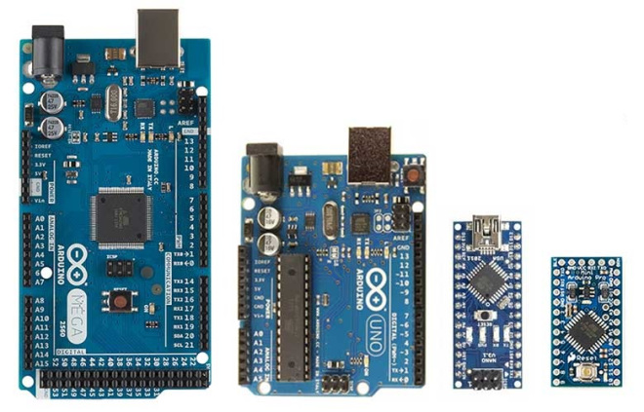
Explanation
ZES ZCOER , Pune
Power Supply :
The Inverter Battery is used as the power supply to our design system.
The system component is consists of various components like arduino development board, current sensor, voltage sensor, display , etc. which required the dc power supply to operate.
Arduino Micro-controller :
Arduino consists of both a physical circuit board and a piece of softwae (IDE)
Ardunio Nano is a 8 bit microcontroller development board, it use ATmega328p microcontroller IC. Ardunio Nano has analog and digital pins.
.
Department of Electrical Engineering

Slide 7
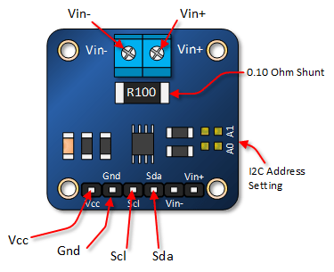
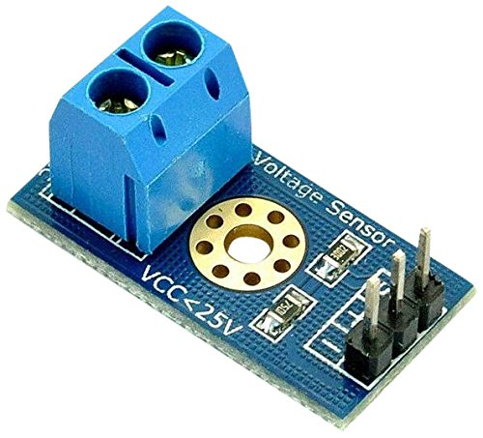
Explanation
ZES ZCOER , Pune
Current Sensor :
Current sensor is a device that detect the electric current in a wire and generates a signal proportional to that current and which is connected in series with load.
Here we are using INA219 current sensor it can be able to measure up to 30 A current.
Voltage Sensor :
The Voltage Sensor Module is a simple but very useful module that uses a potential divider to reduce an input voltage by a factor of 5. The 0-25V Voltage Sensor Module allows you to use the analog input of a microcontroller to monitor voltages much higher than it is capable of sensing.
Department of Electrical Engineering

Slide 8
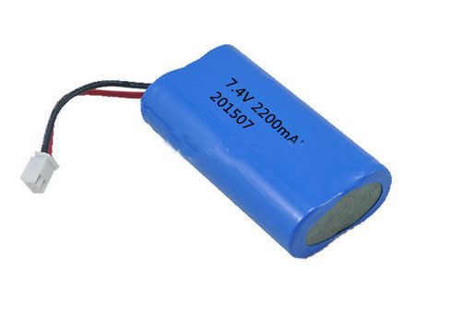
Explanation
ZES ZCOER , Pune
Load :
An electric load is an electric component or portion of a ciruit that consume the electric power, such as electric appliances and lights.
Battery :
Battery is a source of electric power consisting of one or more cells with external connection for powering electric devices.
Here we are using 7.4V 2200 mAh Li-po Rechargeable 2 Cell Battery Pack
Department of Electrical Engineering

Slide 9
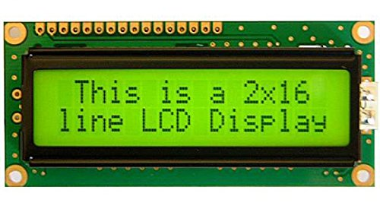
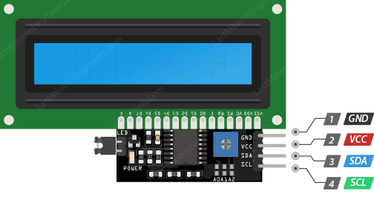
Explanation
ZES ZCOER , Pune
Display :
A seven-segment display is simply sufficient. Consider using a seven-segment display if your Arduino application solely needs to display numbers. This display has seven LEDs arranged into the number eight. They are both cost-effective and easy to use.
However we are using lCD 2x16 display in our project to display the parameters. (i.e. backup time, battery voltage , load current ) And which is interface with arduino through I2C( Inter- integrated Circuit). Use of I2C module can make display easier.
Department of Electrical Engineering

Slide 10
Calculation
ZES ZCOER , Pune
Battery Percentage:
K _{const} = ( V _{high} – V _{low} )
K _{present} = ( V _{high} – V _{present})
Battery Capacity :
Battery
Percentage %
K _{const} - K _{present}
=
__________________________ x 100
K _{const}
(Battery %) x Total Capacity
Present Capacity
=
_________________________________
100
Department of Electrical Engineering

Slide 11
Calculation
ZES ZCOER , Pune
Inverter backup time:
Total watts :
Battery Volt x Battery AH rating
Back up Time of Inverter Battery
_________________________________
=
Total watts on Load.
Total watts (on Load)
Battery Volt x Current
=
Department of Electrical Engineering

Slide 12
Calculation
ZES ZCOER , Pune
Put total watts :
To convert in minutes :
Battery Volt X Battery AH rating
Back up Time of Inverter Battery
( In Hours )
______________________________________
=
Battery Volt X Current
Battery AH rating
=
_______________________
Current
Back up Time of Inverter Battery
( In Min )
Back up Time of Inverter Battery
( In Hours )
60
=
X
Department of Electrical Engineering

Slide 13
Calculation
ZES ZCOER , Pune
Put total watts :
To convert in minutes :
Battery Volt X Battery AH rating
Back up Time of Inverter Battery
( In Hours )
______________________________________
=
Battery Volt X Current
Battery AH rating
=
_______________________
Current
Back up Time of Inverter Battery
( In Min )
Back up Time of Inverter Battery
( In Hours )
60
=
X
Department of Electrical Engineering

Slide 14
Simulation & Result
ZES ZCOER , Pune
Simulation Result:
The simulation of the Inverter Backup Time Indicator is done using Proteus Software.
Department of Electrical Engineering

Slide 15
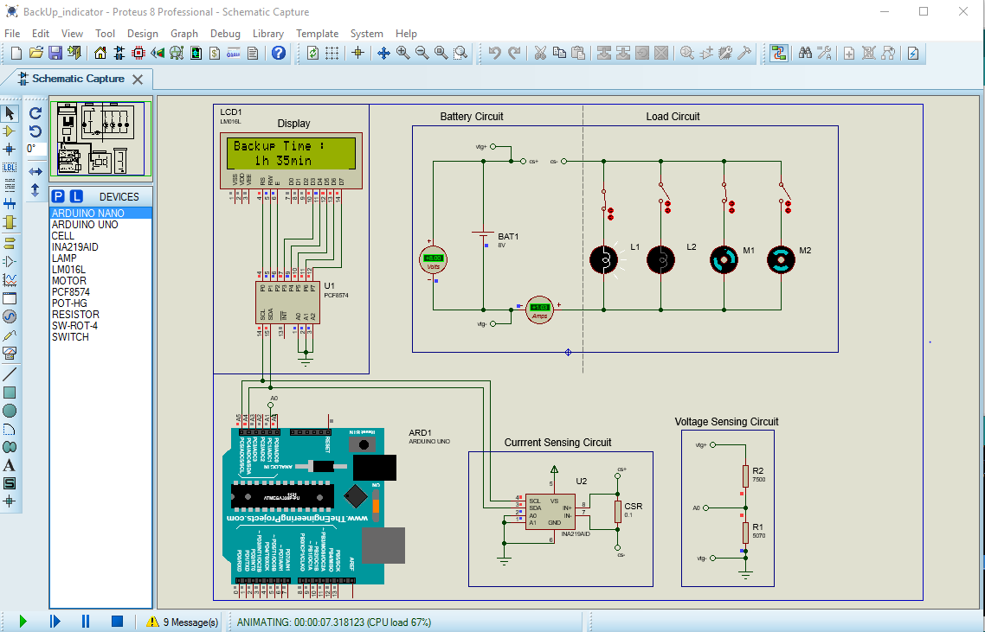
Simulation & Result
ZES ZCOER , Pune
Department of Electrical Engineering

Slide 16
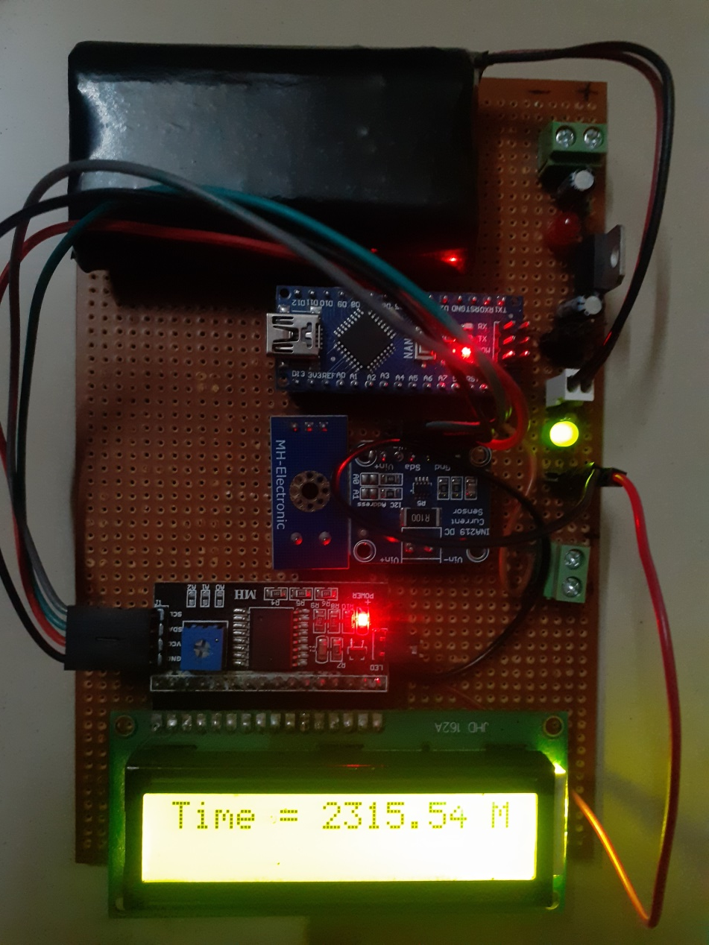
Simulation & Result
ZES ZCOER , Pune
Hardware Result:
Department of Electrical Engineering

Slide 17
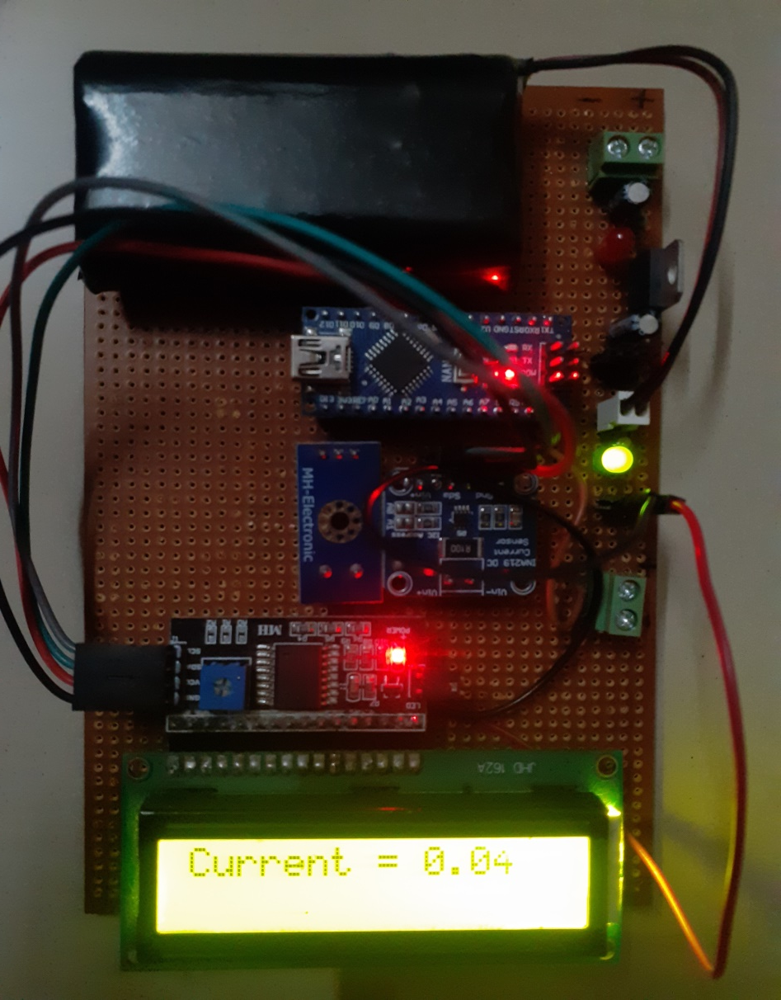
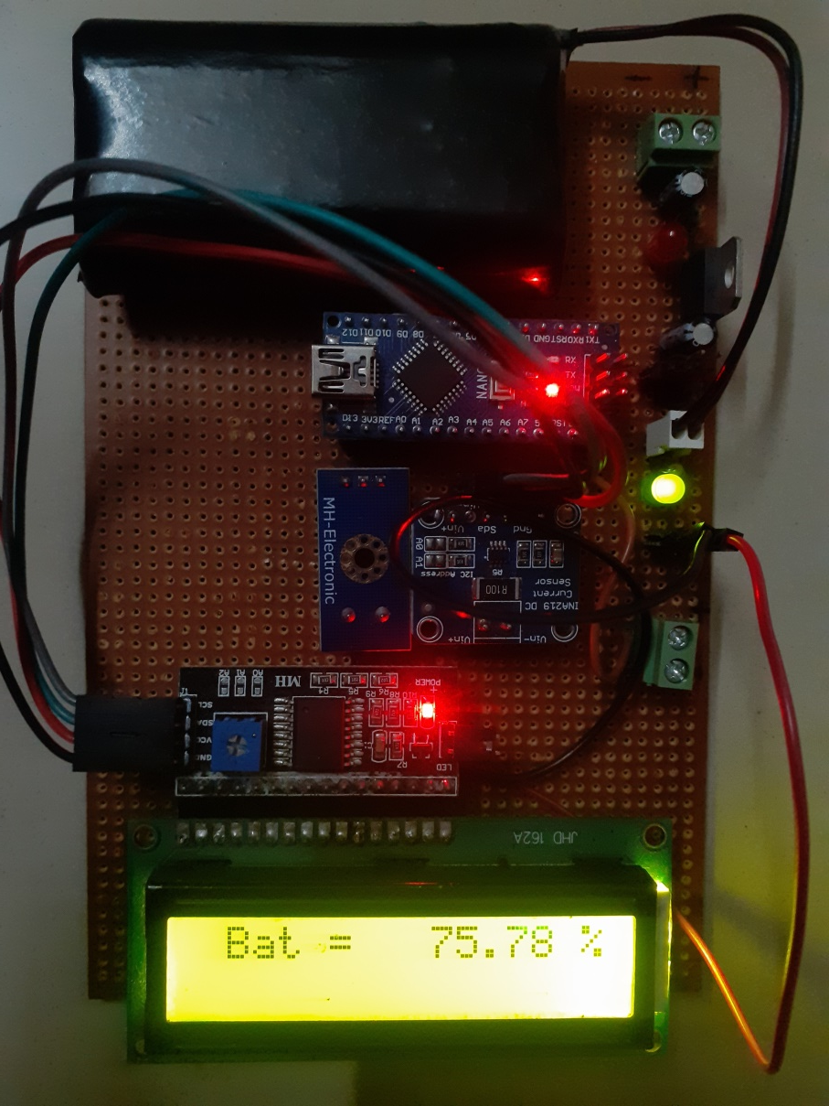
Simulation & Result
ZES ZCOER , Pune
Hardware Result:
Department of Electrical Engineering

Slide 18
Approximate Cost Of Project
ZES ZCOER , Pune
Sr. No. | Components Name | Quantity | Cost (₹)
1. | Arduino Nano | 1 | 960
2. | Voltage sensor 0-25v | 1 | 126
3. | INA 219 current sensor | 1 | 289
4. | Battery 7.4v 2200mah | 1 | 840
5. | I2C module | 1 | 219
6. | LCD 2x16 | 1 | 168
7. | Usb mini B Prog. cable | 1 | 140
8. | Zero pcb | 1 | 69
9. | Other hardware | - | 400
 | Total Cost ( ₹ ) | = | 3211
Department of Electrical Engineering

Slide 19
Advantages
ZES ZCOER , Pune
The circuit required very less power supply for operation.
Arduino nano microcontroller uses ATmega328P microcontroller chip which gives faster operation than old microcontroller like 8051 microcontroller and analog interfacing can directly connected in arduino nano.
This device can be used with any battery by doing some modification in source code of arduino and sensors.
The circuit is compact in size, so less space is required and it can be fitted in small spaces.
The cost of the Inverter Backup Time Indicator is very low.
Department of Electrical Engineering

Slide 20
Applications
ZES ZCOER , Pune
In household applications. To manage the use of household appliances which are operating on the inverter battery.
To determine the load current and backup time of the battery.
In backup power supply of commercial, industrial and residential where battery is used to supply the backup power.
It can be used in inverter battery or any other battery for monitoring the battery voltage and backup time of that battery.
Department of Electrical Engineering

Slide 21
Conclusion
ZES ZCOER , Pune
The inverter backup indicator will help us to find out how many time will survive inverter battery or any battery which is connected to the system on applied load.
This device will display the current, voltage, capacity in percentage and remaining backup time of the inverter on LCD display which provided on the device. It helps the consumer to track the inverter battery. Due to small size of inverter backup indicator it can be easy placed on any inverter.
Department of Electrical Engineering

Slide 22
ZES ZCOER , Pune
Thank You…
Department of Electrical Engineering

